Slide 1
Relational Data Model
Chapter 5-<number>

Slide 2
Outline
Relational Model Concepts
Relational Model Constraints
Relational Database Schemas

Slide 3
Relational Model Concepts
The relational Model of Data is based on the concept of a Relation.
A Relation is a mathematical concept based on the ideas of sets.
The relational model represents the database as a collection of relations.

Slide 4
Relational Model Concepts
The model was first proposed by Dr. E.F. Codd of IBM in 1970 in the following paper:
"A Relational Model for Large Shared Data Banks," Communications of the ACM, June 1970.
The above paper caused a major revolution in the field of Database management and earned Ted Codd the coveted ACM Turing Award.

Slide 5
INFORMAL DEFINITIONS
RELATION: A table of values
  A relation may be thought of as a set of rows.
  A relation may alternately be though of as a set of columns.
  Each row represents a fact that corresponds to a real-world entity or relationship.
  Each row has a value of an item or set of items that uniquely identifies that row in the table.
  Sometimes row-ids or sequential numbers are assigned to identify the rows in the table.
  Each column typically is called by its column name or column header or attribute name.

Slide 6
FORMAL DEFINITIONS
A Relation may be defined in multiple ways.
The Schema of a Relation: R (A1, A2, .....An)
Relation schema R is defined over attributes A1, A2, .....An
For Example -
CUSTOMER (Cust-id, Cust-name, Address, Phone#)
Here, CUSTOMER is a relation defined over the four attributes Cust-id, Cust-name, Address, Phone#, each of which has a domain or a set of valid values. For example, the domain of Cust-id is 6 digit numbers.

Slide 7
FORMAL DEFINITIONS
A tuple is an ordered set of values
Each value is derived from an appropriate domain.
Each row in the CUSTOMER table may be referred to as a tuple in the table and would consist of four values.
<632895, "John Smith", "101 Main St. Atlanta, GA 30332", "(404) 894-2000">
is a tuple belonging to the CUSTOMER relation.
A relation may be regarded as a set of tuples (rows).
Cardinality: number of tuples
Columns in a table are also called attributes of the relation.
Degree: number of attributes

Slide 8
FORMAL DEFINITIONS
A domain has a logical definition: e.g.,
“USA_phone_numbers” are the set of 10 digit phone numbers valid in the U.S.
A domain may have a data-type or a format defined for it. The USA_phone_numbers may have a format: (ddd)-ddd-dddd where each d is a decimal digit. E.g., Dates have various formats such as monthname, date, year or yyyy-mm-dd, or dd mm,yyyy etc.
An attribute designates the role played by the domain. E.g., the domain Date may be used to define attributes “Invoice-date” and “Payment-date”.

Slide 9
FORMAL DEFINITIONS
The relation is formed over the cartesian product of the sets; each set has values from a domain; that domain is used in a specific role which is conveyed by the attribute name.
For example, attribute Cust-name is defined over the domain of strings of 25 characters. The role these strings play in the CUSTOMER relation is that of the name of customers.
Formally,
Given R(A₁, A₂, .........., A_{n})
  r(R) ⊂ dom (A₁) X dom (A₂) X ....X dom(A_{n})
R: schema of the relation
r of R: a specific "value" or population of R.
R is also called the intension of a relation
r is also called the extension of a relation

Slide 10
FORMAL DEFINITIONS
Let S1 = {0,1}
Let S2 = {a,b,c}
Let R ⊂ S1 X S2
Then for example: r(R) = {<0,a> , <0,b> , <1,c> }
is one possible “state” or “population” or “extension” r of the relation R, defined over domains S1 and S2. It has three tuples.
r(R): a set of n-tuples

Slide 11
DEFINITION SUMMARY
Informal Terms |  | Formal Terms
Table |  | Relation
Column |  | Attribute/Domain
Row |  | Tuple
Values in a column |  | Domain
Table Definition |  | Schema of a Relation
Populated Table |  | Extension

Slide 12
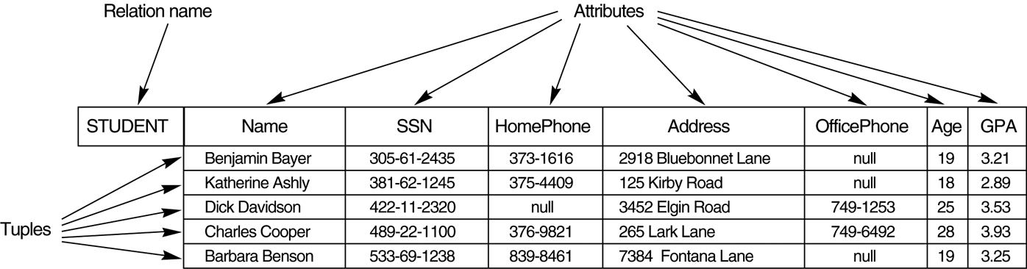
Example - Figure 1

Slide 13
CHARACTERISTICS OF RELATIONS
Ordering of tuples in a relation r(R): The tuples are not considered to be ordered, even though they appear to be in the tabular form.
Ordering of attributes in a relation schema R (and of values within each tuple): the attributes in R(A₁, A₂, ..., A_{n}) and the values in t=<v₁, v₂, ..., v_{n}> to be ordered .
Values in a tuple: All values are considered atomic (indivisible). A special null value is used to represent values that are unknown or inapplicable to certain tuples.

Slide 14
CHARACTERISTICS OF RELATIONS
Notation:
- We refer to component values of a tuple t by t[A_{i}] = v_{i} (the value of attribute A_{i} for tuple t).
Similarly, t[A_{u}, A_{v}, ..., A_{w}] refers to the subtuple of t containing the values of attributes A_{u}, A_{v}, ..., A_{w}, respectively.

Slide 15
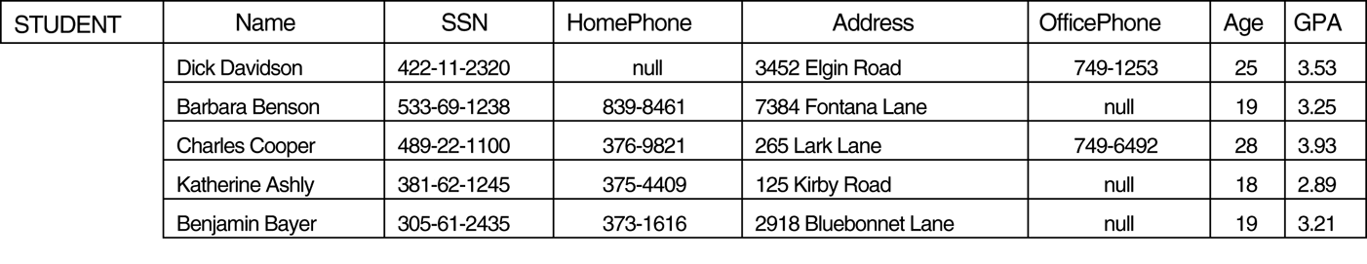
CHARACTERISTICS OF RELATIONS- Figure 2
Relation STUDENT with a different order of tuples

Slide 16
Relational Integrity Constraints
Constraints are conditions that must hold on all valid relation instances. There are three main types of constraints:
  Key constraints
  Entity integrity constraints
  Referential integrity constraints

Slide 17
Key Constraints
Superkey of R: A set of attributes SK of R such that no two tuples in any valid relation instance r(R) will have the same value for SK. That is, for any distinct tuples t1 and t2 in r(R), t1[SK] ≠ t2[SK].
Key of R: A "minimal" superkey; that is, a superkey K such that removal of any attribute from K results in a set of attributes that is not a superkey.
  Example: The CAR relation schema:
  CAR(State, Reg#, SerialNo, Make, Model, Year)
  has two keys Key1 = {State, Reg#}, Key2 = {SerialNo}, which are also superkeys. {SerialNo, Make} is a superkey but not a key.
If a relation has several candidate keys, one is chosen arbitrarily to be the primary key. The primary key attributes are underlined.

Slide 18
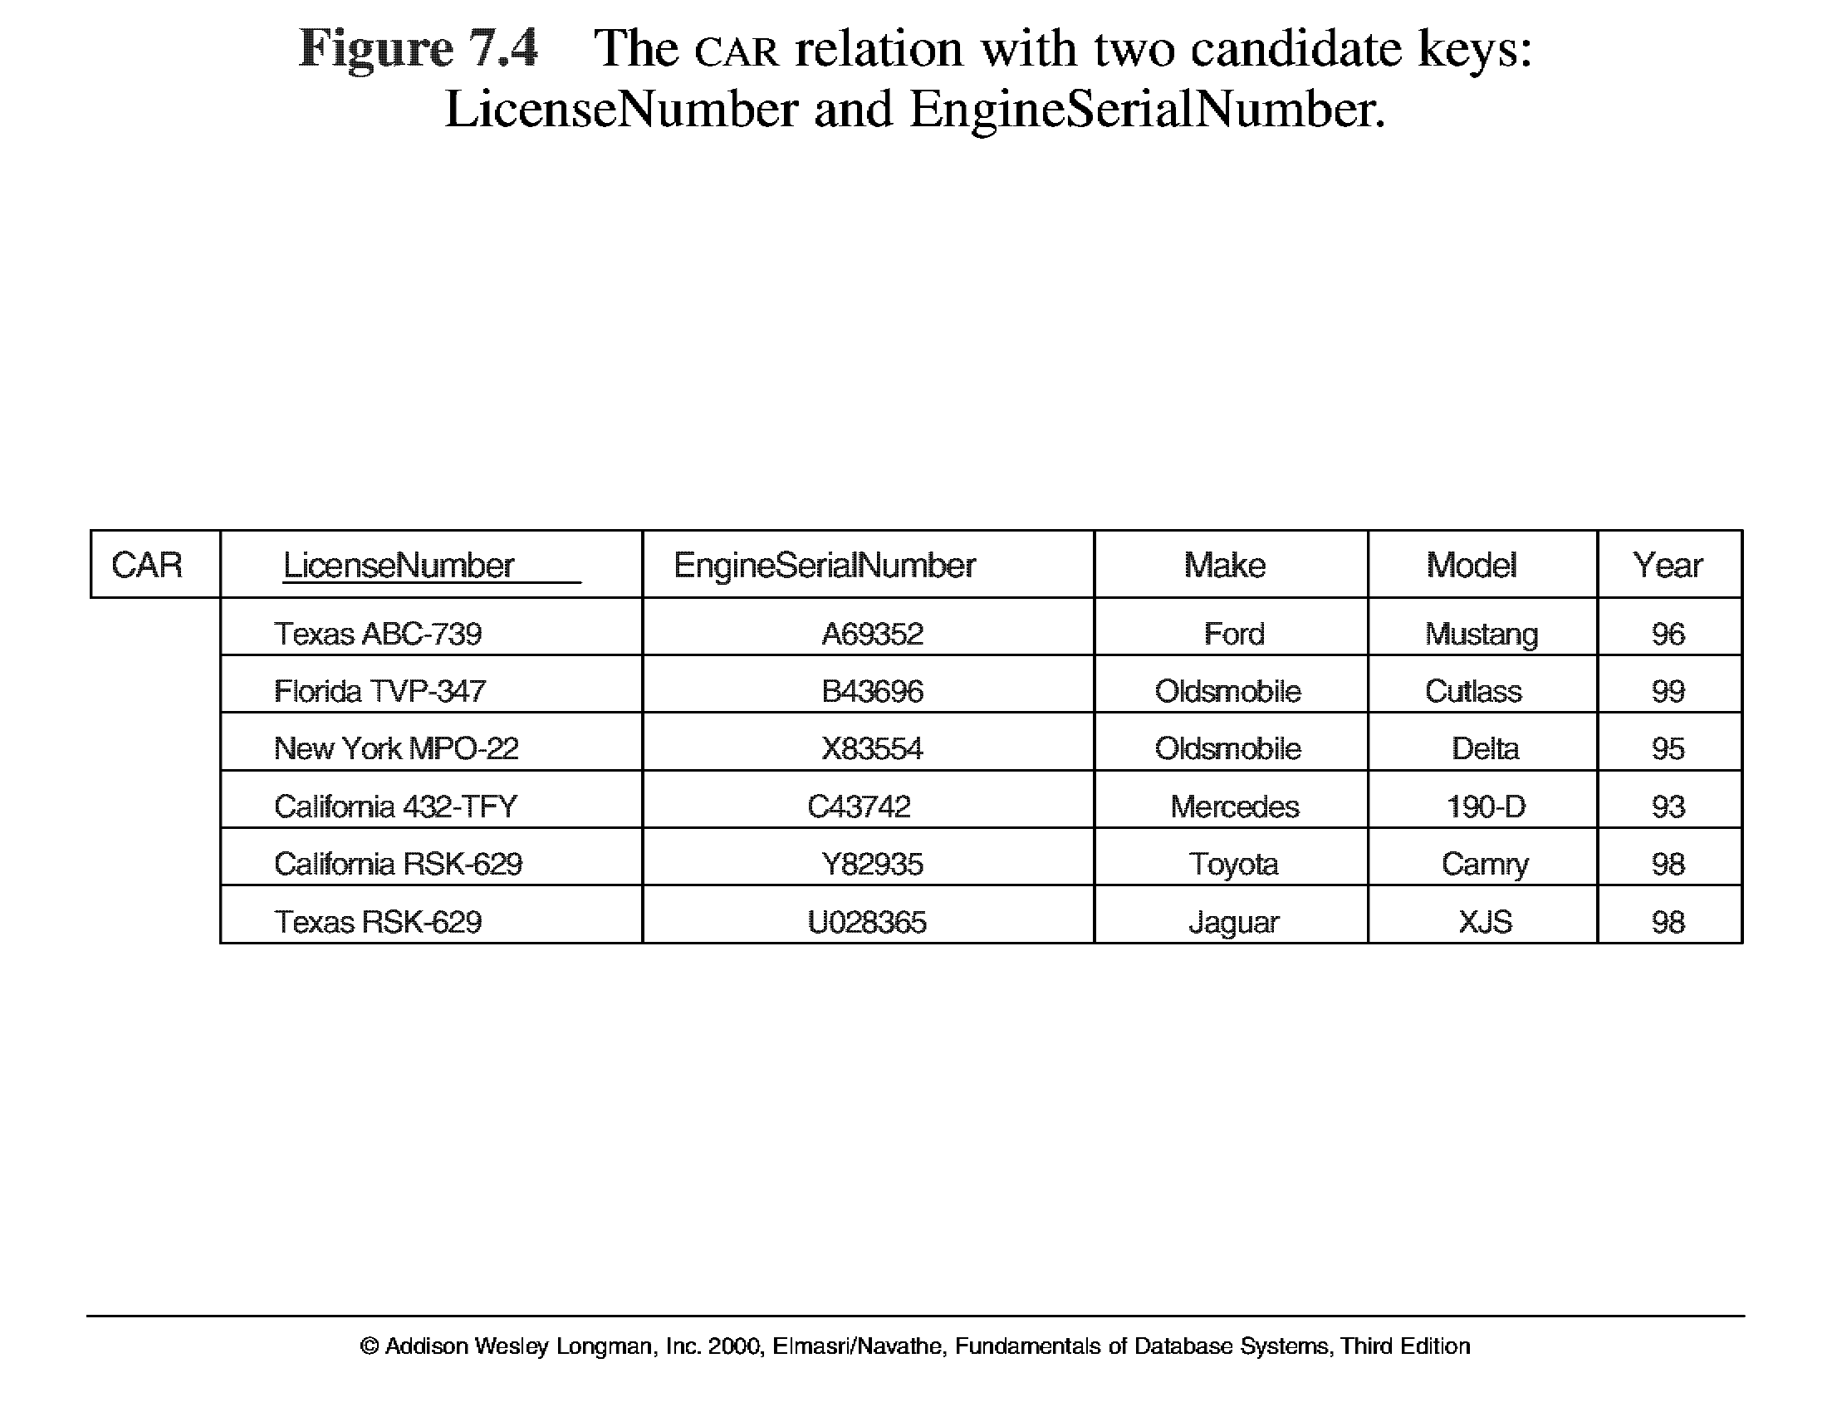
Key Constraints
3

Slide 19
Entity Integrity
Relational Database Schema: A set S of relation schemas that belong to the same database. S is the name of the database.
S = {R₁, R₂, ..., R_{n}}
Entity Integrity: The primary key attributes PK of each relation schema R in S cannot have null values in any tuple of r(R). This is because primary key values are used to identify the individual tuples.
t[PK] ≠ null for any tuple t in r(R)
Note: Other attributes of R may be similarly constrained to disallow null values, even though they are not members of the primary key.

Slide 20
Referential Integrity
A constraint involving two relations (the previous constraints involve a single relation).
Used to specify a relationship among tuples in two relations: the referencing relation and the referenced relation.
Tuples in the referencing relation R₁ have attributes FK (called foreign key attributes) that reference the primary key attributes PK of the referenced relation R₂. A tuple t₁ in R₁ is said to reference a tuple t₂ in R₂ if t₁[FK] = t₂[PK].
A referential integrity constraint can be displayed in a relational database schema as a directed arc from R₁.FK to R₂.PK

Slide 21
Referential Integrity
Constraint
Statement of the constraint
The value in the foreign key column (or columns) FK of the the referencing relation R₁ can be either:
(1) a value of an existing primary key value of the corresponding primary key PK in the referenced relation R_{2,}, or..
(2) a null.
In case (2), the FK in R₁ should not be a part of its own primary key.

Slide 22
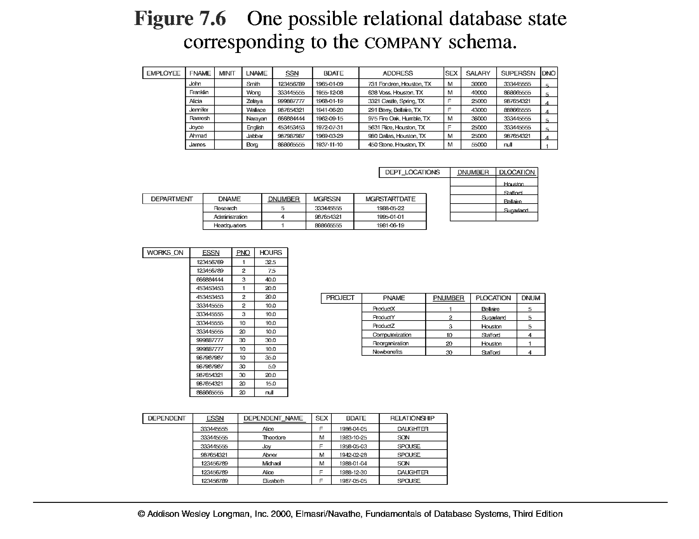
5

Slide 23
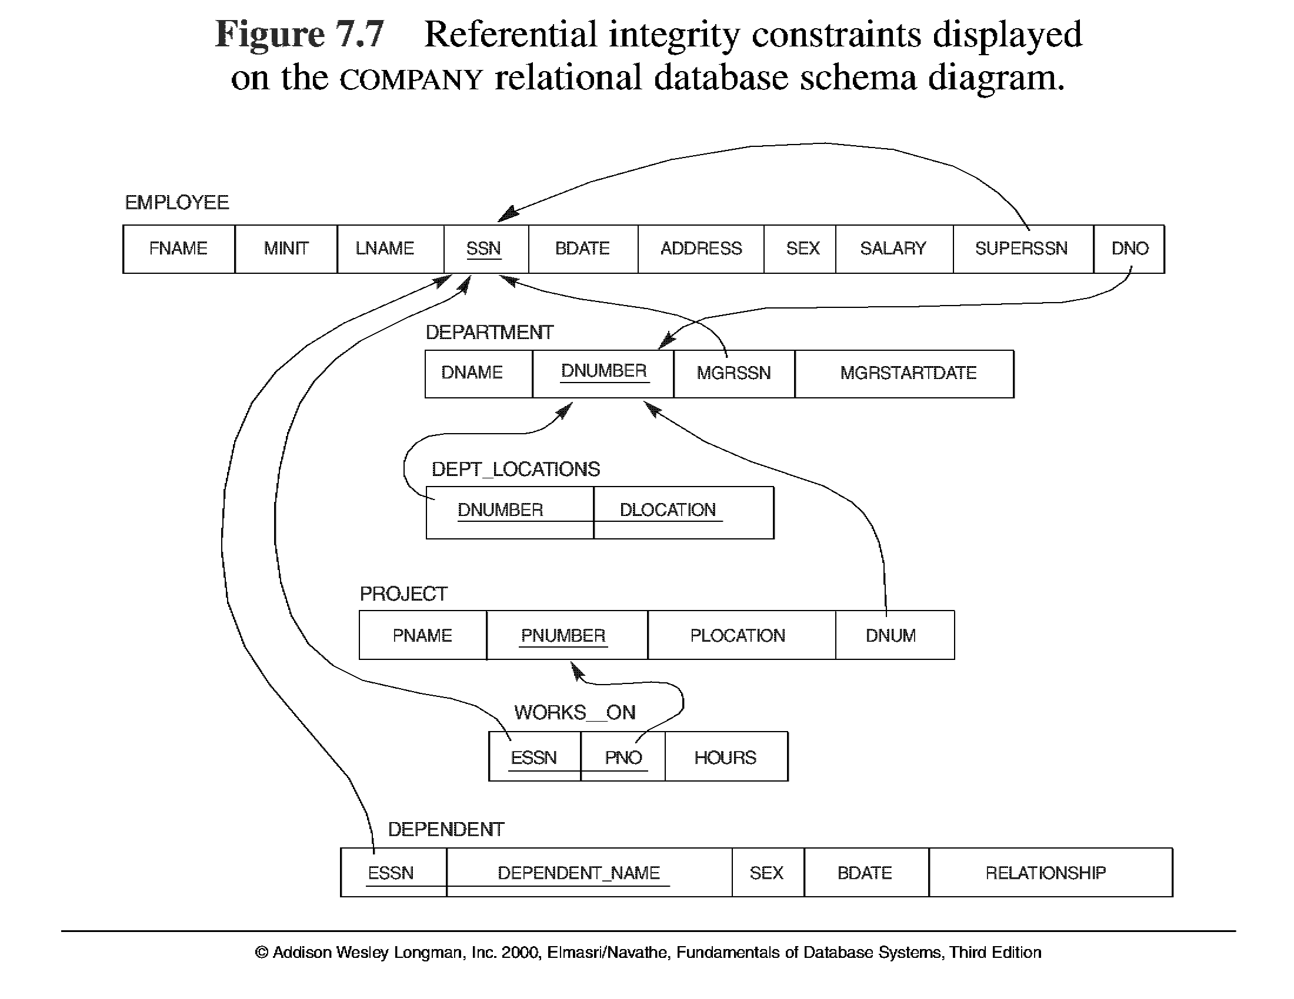
6

Slide 24

Schema diagram
Chapter 5-<number>

